Slide 1

Underwriting Loan Prediction
By
Meghana Udiga
Akhil Yada
Venu Dodda
Pavan Chaitanya

Slide 2
Index
Project Goal
Overview of Data
Modelling Strategy
Model Performance
Insights and Conclusion

Slide 3
Project Goal
The group project aims to use advanced machine learning techniques to assess the likelihood of loan defaults and resulting financial loss.
This differs from traditional finance-based methods and aims to bridge the gap between traditional banking and modern asset management practices.
The project is timely due to the growing trend of machine learning in finance, and successful completion can improve risk management for financial investors.

Slide 4
Overview of Data
The dataset was organized by client ID numbers and various variables, making it difficult to incorporate the likelihood of default and severity of losses.
The column labels provided were not descriptive, limiting domain-specific knowledge, so data preparation and correlation analysis were relied upon to identify trends and relationships.
A meticulous data cleaning process was conducted to identify clients who had defaulted on their loans, where a "loss" column was discovered.

Slide 5


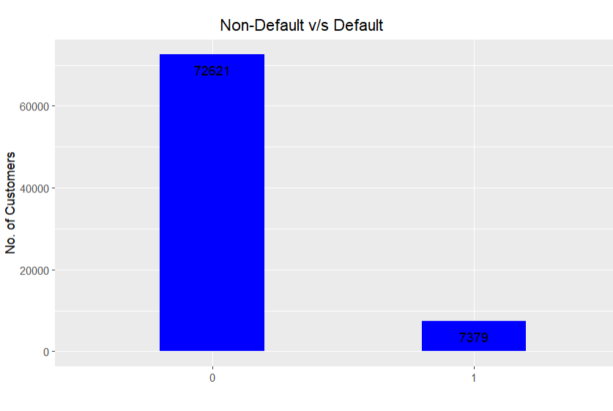

Overview of data
Clients with a zero value in the column had paid off their loans without defaulting, while those with a numerical value greater than zero had defaulted.

Slide 6
Modelling Strategy
We have built 2 models for this project.
1)Classification Model.
Lasso Model
Principle Component Analysis
Random Forest

Slide 7
Classification Model
Why: The classification model helps to predict which customers are likely to default based on their loans.
Lasso Model:
1. The Lasso model was used to perform variable selection on the new_bank_model dataset using alpha=1 and family="binomial" with 10-fold cross-validation, resulting in 180 selected attributes.
2. The selected attributes were used to create a new dataset called bank_lasso, which was then used in PCA modeling.
Principle Component Analysis:
1. PCA was used on the bank_lasso dataset to capture 80% of the variance and generate pca_model_1 consisting of 69 components.
2. A training and validation set were created from pca_model_1 for the classification model.
Random Forest:
1. Random Forest algorithm was used to predict the loss amount for each customer.
2. The final model was evaluated using RMSE and R-squared metrics after pre-processing the dataset by centering and scaling and setting the tree parameter to 1000.

Slide 8
Regression Model
Why: Regression Model helps to predict the loss amount for each customer.
Regression is used to model and investigate the relationship between a dependent variable and one or more independent variables in order to predict future outcomes, identify important predictors, understand the relationship between variables, and control for confounding factors.

Slide 9
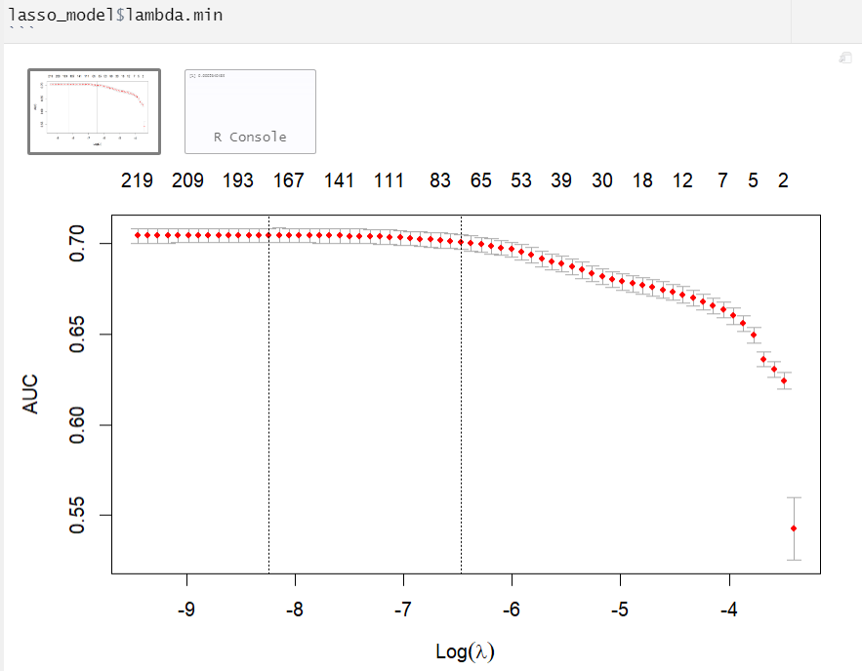
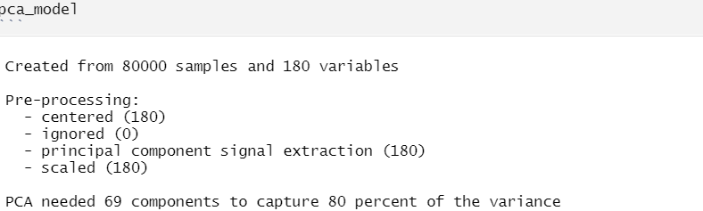
Model performance

Slide 10
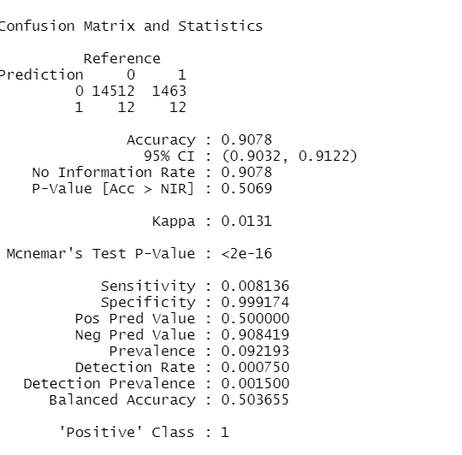
Model Performance

Slide 11
Insights and Conclusion
This study utilized three machine learning models, Lasso, PCA, and Random Forest algorithm, to predict the underwriting loan prediction project.
Lasso was used to selecting important variables and pick 180 attributes. PCA was applied to these attributes, resulting in 69 components capturing 80% of the variance.
Finally, the Random Forest algorithm was applied to the PCA model's output, achieving an accuracy of 90%.

Slide 12
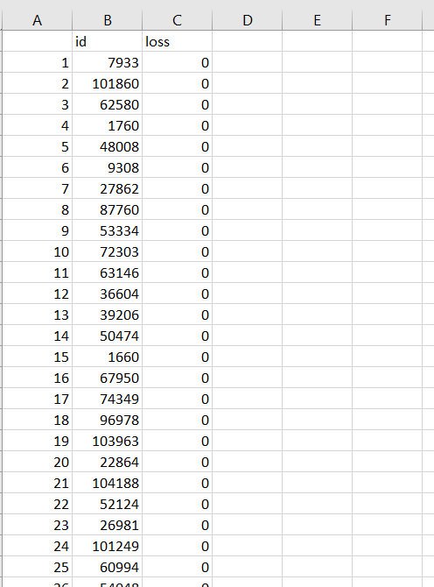
Insight and conclusion

Slide 13
Thank you

